Slide 1


Emotion Physiology and Experience Collaboration

Slide 2
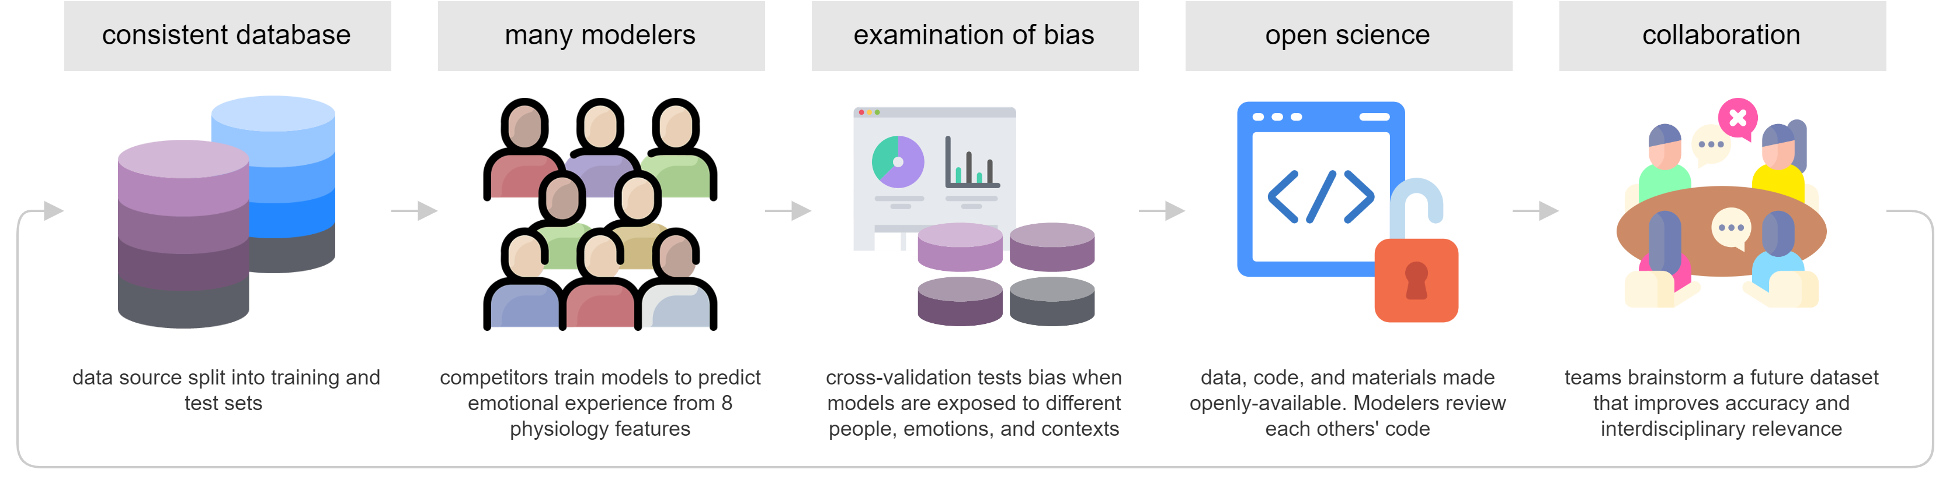
Emotion Physiology and Experience Competition (EPiC)

Slide 3







Slide 4


